Slide 1

TechX Software Engineer Internship
By Misha Ward
Advisor: Marc Dupuis

Slide 2
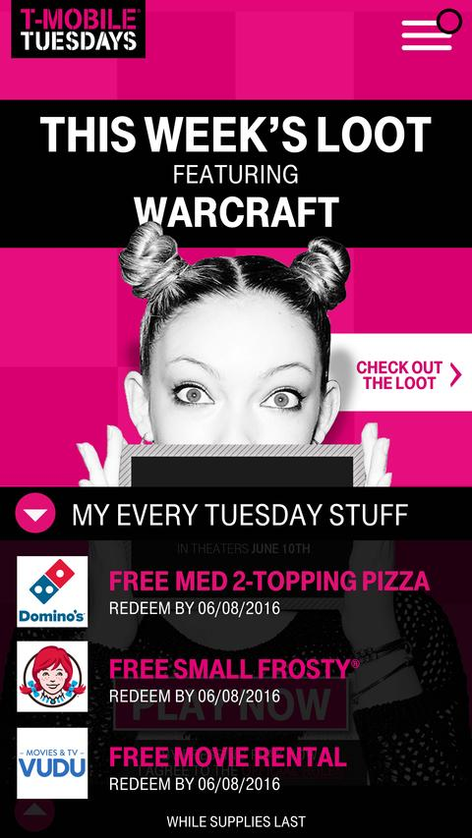
Background
First internship in technology field
Worked roughly 15-20 hours a week
Two rotations
DELTA Team
October to February
T-Mobile Tuesdays
February to June

Slide 3

What did I work on for the Delta team?
Read documentation
Coordinated with different teams
Added reactive UI component to internal site using jQuery

Slide 4

What did I work on for T-Mobile Tuesdays?
Worked on the iOS app team
Made UI improvements to the T-Mobile Tuesday app
Fixed bugs
Did third party API integration into the system
Added features to the application

Slide 5

What went well?
Experience using different tools
Learned industry tech stack
Learned a lot
Made friends
No bugs from my code

Slide 6

What challenges have I faced?
Syncing with busy managers or people in different offices
Ramping up on new team
Learning new languages
Ambiguous start
Who I reported to (Delta team)

Slide 7

How did I overcome these challenges?
Communication
About responsibilities, following up if I didn’t get a reply
Read documentation and asked for help ramping up
Did tutorials for tools and languages I didn’t know

Slide 8

What have I learned?
Industry tech stack
Bitbucket
Slack communication
Xcode
Swift
Python
jQuery

Slide 9
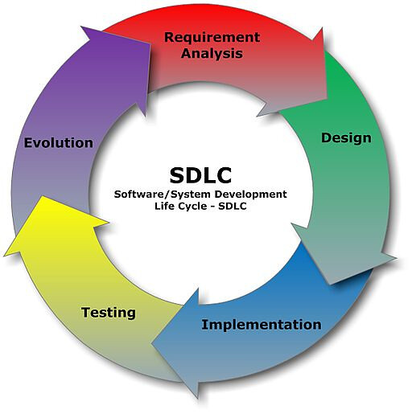
How does this relate to my degree?
Applied material learned in school in an industry setting
CSS 478: Usability And User-Centered Design
CSS 360: Software Engineering
CSS 490: Cloud Computing
CSS 490: Machine Learning
Notes:
CSS 478: Usability And User-Centered Design
-Used for both teams
-Helped guide unknown UX decisions
-Updated code to enhance user experience
CSS 490: Cloud Computing
-Used APIs
-Experience with REST
CSS 490: Machine Learning
-Researched Ingram natural language processing
CSS 360: Software Engineering
-A/B testing (Firebase)
-Agile development
-Version control

Slide 10

How does my experience relate to my career?
Experience with project management
Experience with software engineering
Used industry standard tools
Met people for future networking

Slide 11

Advice for other students
Apply early, start studying for interviews yesterday
Communication is incredibly important
Ask for help when you are stuck

Slide 12

Thanks!
Any questions?

Slide 13

Acknowledgments
Advisor: Marc Dupuis
Manager: Prabha Chinsawarmy
T-Mobile Tuesdays & Delta Teams

